Slide 1
Low Power Scheduling For High Level Synthesis
Hardware Software Co-Design

Slide 2

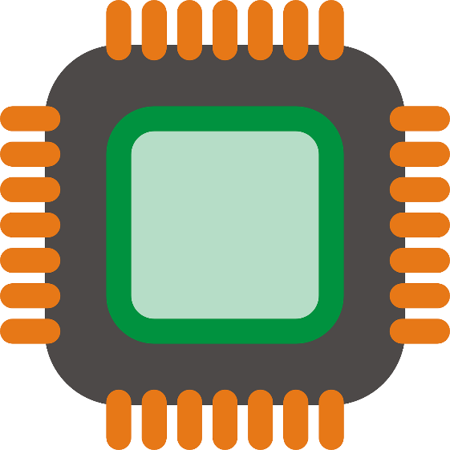

Motivation

Slide 3
Why High Level Synthesis (HLS)?
Power consumption can be reduced by:
Reducing chip and package capacitance → Expensive.
Scaling the supply voltage → Need extra circuits.
Better design techniques → Cost-effective.
Power management strategies → significant power savings.
Solution: Integrate power scheduler in High Level Synthesis (HLS) [1].

Slide 4
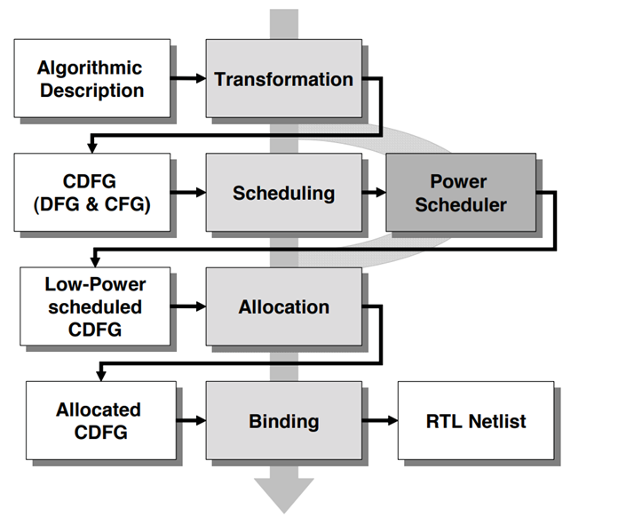
What is HLS?
Translation function from behavioural to structural description [3].
Three phases [1]:
Scheduling: which clock cycle?
Allocation: how many resources?
Binding: which operation to which resource?
Fig. 1: HLS Design Flow with Power Scheduler integrated [1]

Slide 5
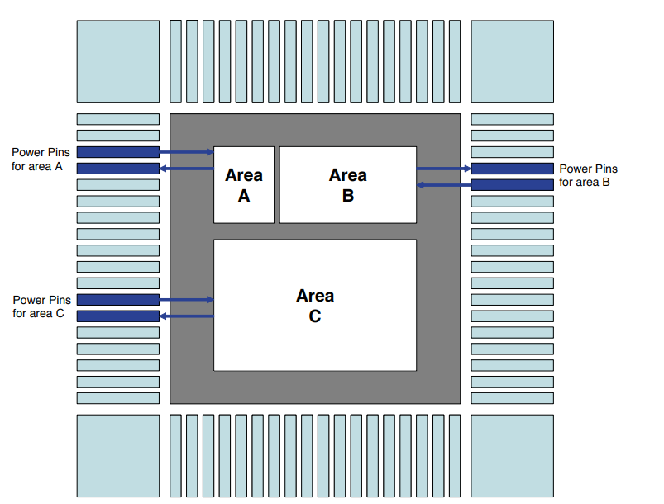
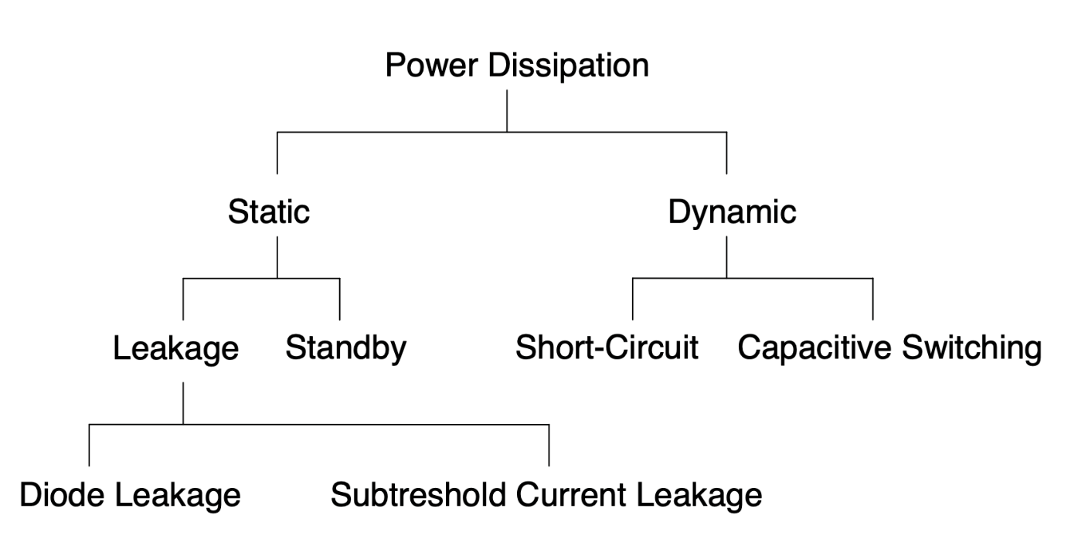
Dissipation source and reduction method
Fig. 2: Sources of power dissipation [1]
Fig. 3: Power down [1]

Slide 6
Strategy
Goal 1: Dedicated turn-on and turn-off mechanisms.
Goal 2: Minimizing control components for those mechanisms.
Technique: Power down.
Scheduling method: Partitioning.

Slide 7
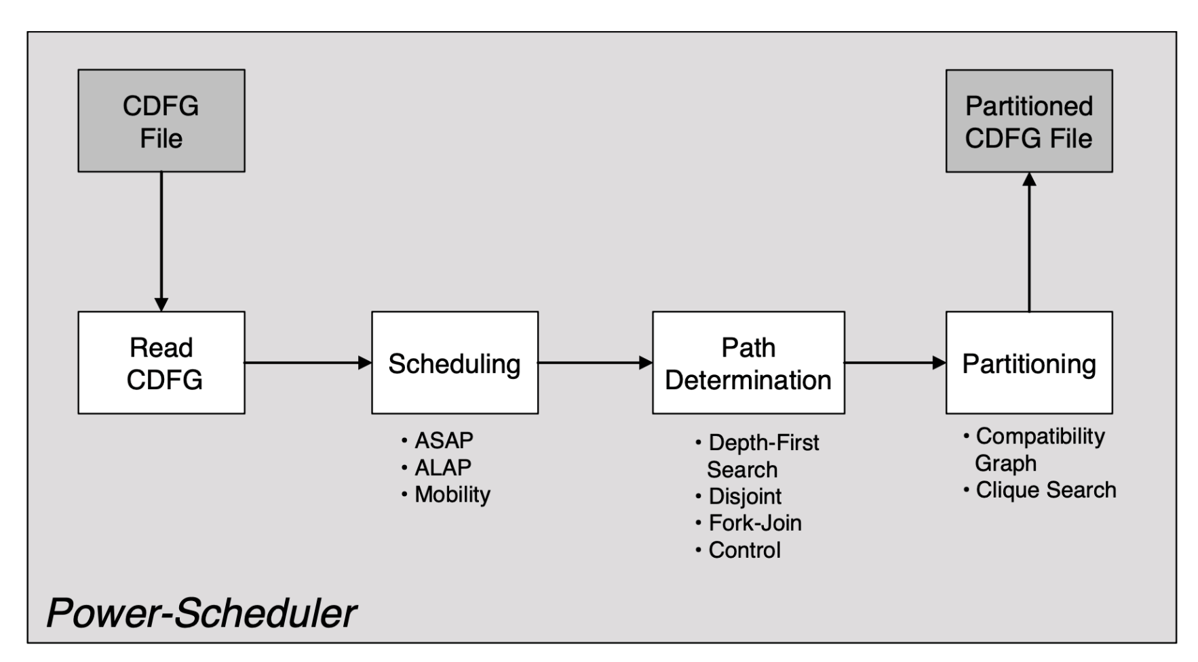
Flow of Power scheduler
Fig. 4: Steps of Power Scheduler [1].

Slide 8
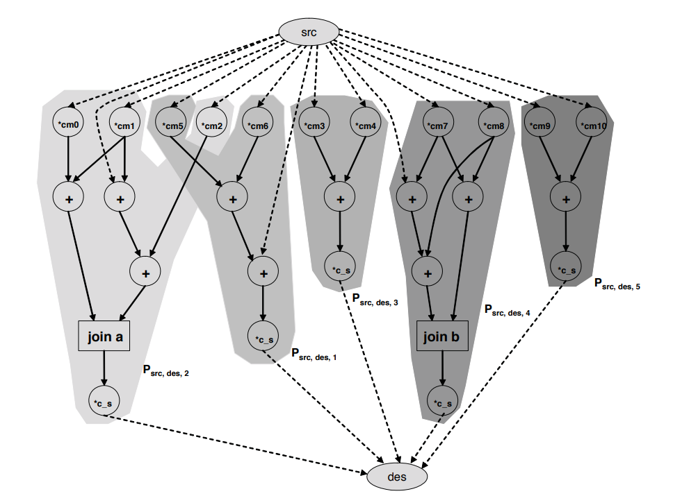
DISJOIN path calculation
Fig. 5: Fork-join path analysis [1].

Slide 9
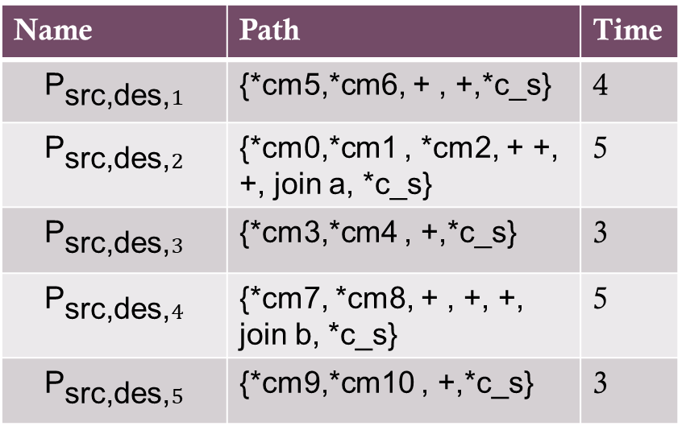
DISJOIN path calculation
* : 2 timesteps
+ : 1 timestep.
Name | Path | Time
$${\text{P}}_{\text{src}\text{,}\text{des}\text{,}1}$$ | {*cm5,*cm6, + , +,*c_s} | 4
$${\text{P}}_{\text{src}\text{,}\text{des}\text{,}2}$$ | {*cm0,*cm1 , *cm2, + +, +, join a, *c_s} | 5
$${\text{P}}_{\text{src}\text{,}\text{des}\text{,}3}$$ | {*cm3,*cm4 , +,*c_s} | 3
$${\text{P}}_{\text{src}\text{,}\text{des}\text{,}4}$$ | {*cm7, *cm8, + , +, +, join b, *c_s} | 5
$${\text{P}}_{\text{src}\text{,}\text{des}\text{,}5}$$ | {*cm9,*cm10 , +,*c_s} | 3
Table 1: Determined path from disjoint paths [1].
Fig. 5: Fork-join path analysis [1].

Slide 10
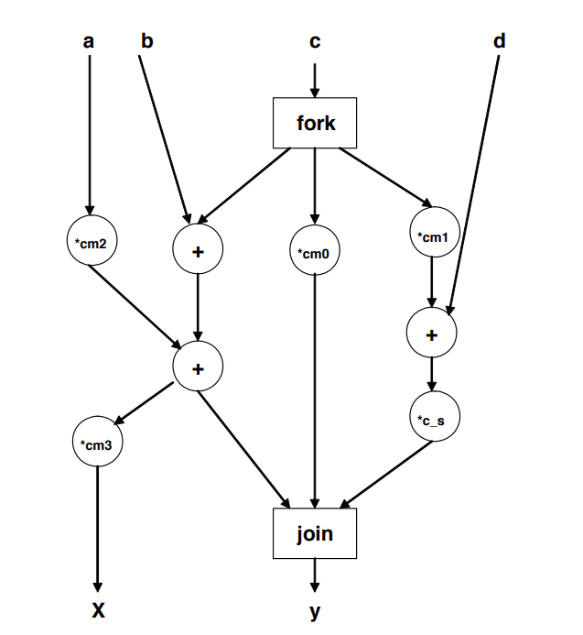
Fork-Join path calculation
Fig. 6: Fork-join path analysis [2].

Slide 11
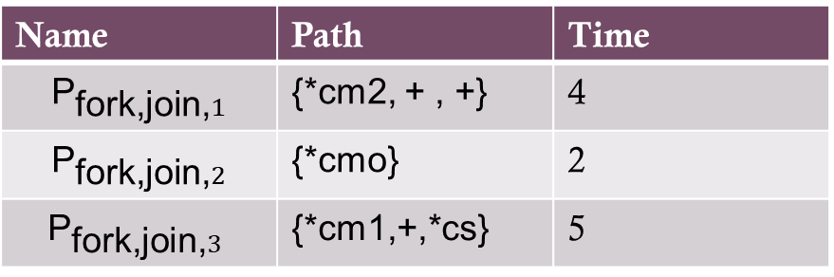
Fork-Join path calculation
* : 2 timesteps
+ : 1 timestep.
Name | Path | Time
$${\text{P}}_{\text{fork}\text{,}\text{join}\text{,}1}$$ | {*cm2, + , +} | 4
$${\text{P}}_{\text{fork}\text{,}\text{join}\text{,}2}$$ | {*cmo} | 2
$${\text{P}}_{\text{fork}\text{,}\text{join}\text{,}3}$$ | {*cm1,+,*cs} | 5
Table 2: Determined path from fork-join paths [1].
Fig. 6: Fork-join path analysis [2].

Slide 12
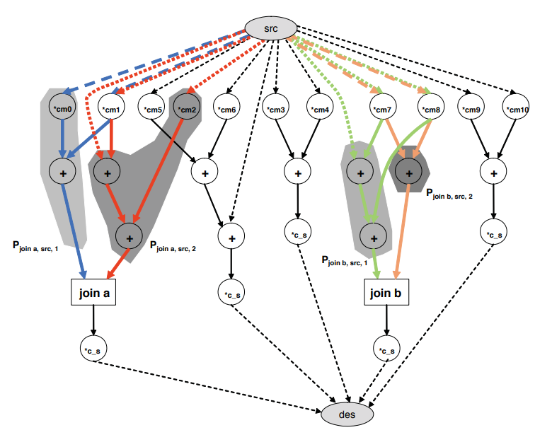
Control path calculation
Fig. 7: Control path analysis [1].

Slide 13
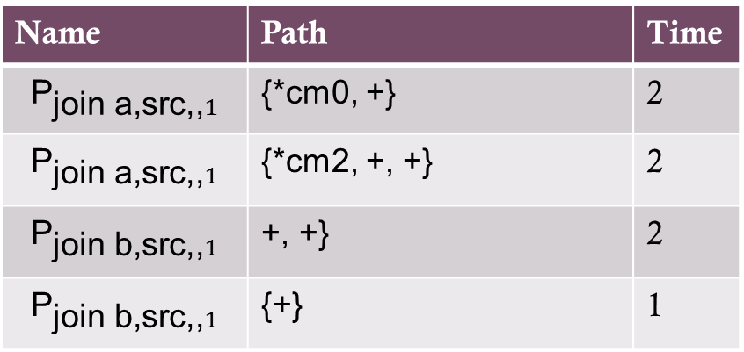
Control path calculation
* : 2 timesteps
+ : 1 timestep.
Name | Path | Time
$${\text{P}}_{\text{join} \text{a}\text{,}\text{src}\text{,,}1}$$ | {*cm0, +} | 2
$${\text{P}}_{\text{join} \text{a}\text{,}\text{src}\text{,,}1}$$ | {*cm2, +, +} | 2
$${\text{P}}_{\text{join} \text{b}\text{,}\text{src}\text{,,}1}$$ | +, +} | 2
$${\text{P}}_{\text{join} \text{b}\text{,}\text{src}\text{,,}1}$$ | {+} | 1
Table 3: Determined path from control paths [1].
Fig. 7: Control path analysis [1].

Slide 14
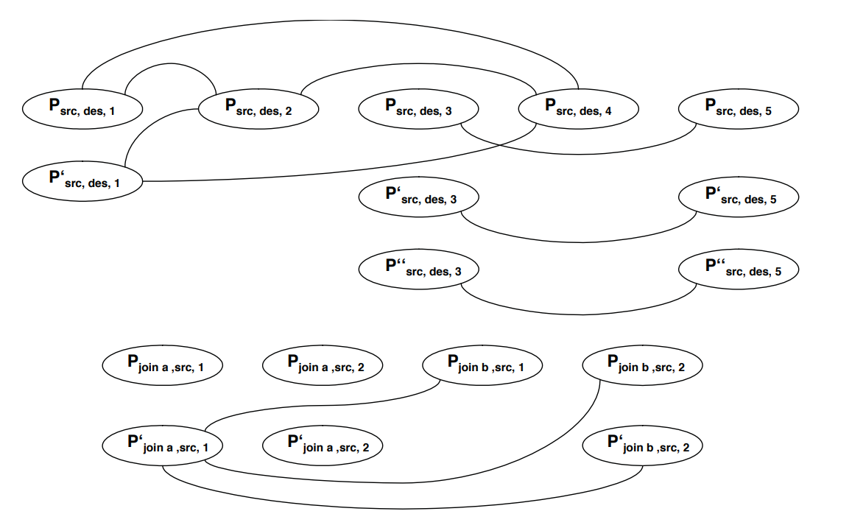
Compatibility Graph
Fig. 8: Formation of compatibility graph [1].

Slide 15
Compatibility Graph
Fig. 8: Formation of compatibility graph [1].

Slide 16
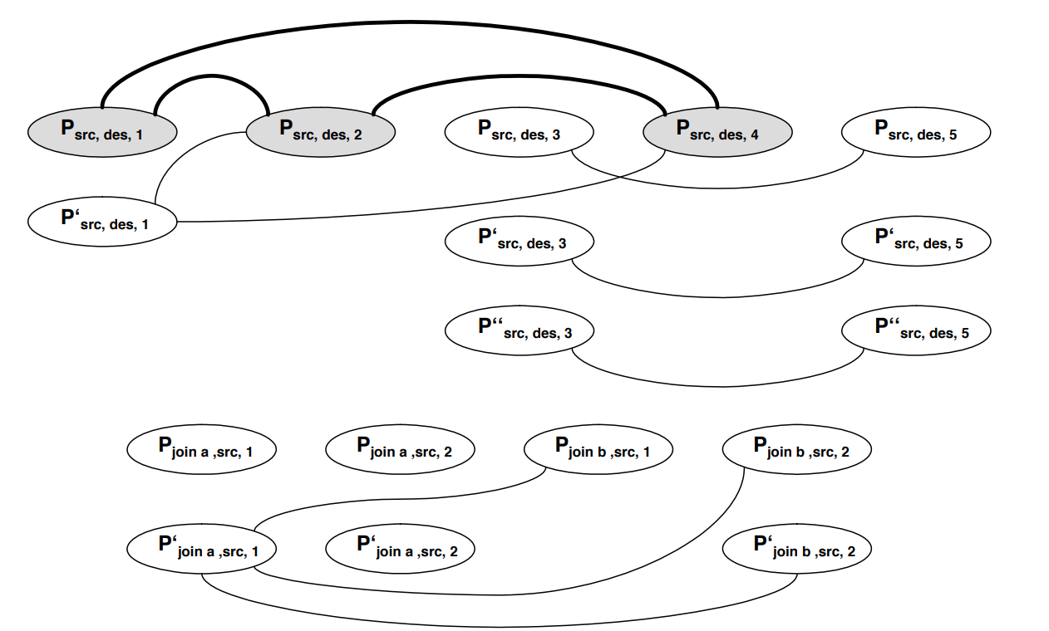
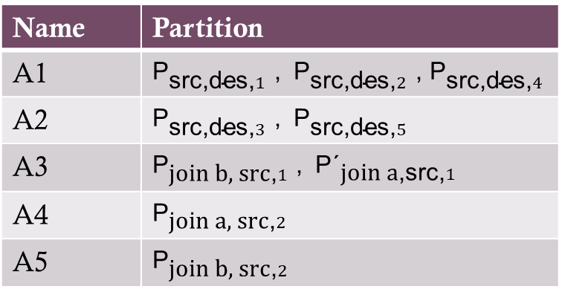
Clique Search
Name | Partition
A1 | ${\text{P}}_{\text{src}\text{,}\text{des}\text{,}1}$ , ${\text{P}}_{\text{src}\text{,}\text{des}\text{,}2}$ , ${\text{P}}_{\text{src}\text{,}\text{des}\text{,}4}$
A2 | ${\text{P}}_{\text{src}\text{,}\text{des}\text{,}3}$ , ${\text{P}}_{\text{src}\text{,}\text{des}\text{,}5}$
A3 | ${\text{P}}_{\text{join} \text{b}\text{, }\text{src}\text{,}1}$ , ${\text{P}\text{´}}_{\text{join} \text{a}\text{,}\text{src}\text{,}1}$
A4 | ${\text{P}}_{\text{join} \text{a}\text{, }\text{src}\text{,}2}$
A5 | ${\text{P}}_{\text{join} \text{b}\text{, }\text{src}\text{,}2}$
Table 4: Partitions determined from clique search [1].
Fig. 11: Clique search from compatibility graph[1].

Slide 17
Overview and Conclusion
 | Partitioned | Unpartitioned
Power consumption | 1008000 μJ | 1180000 μJ
Table 5: Difference in energy consumption between partitioned and unpartitioned approach [1].
Low power driven synthesis is discussed.
A developed power scheduler is the focus.
Scheduler produces partitioned CDFG.
Partition allows for dedicated turn-on and turn-off mechanism.
Part of MPEG-2 algorithm is used as an example.
Energy saving of 15% achieved [4].

Slide 18
References
[1] Achim Rettberg, Bernd Kleinjohann, and Franz Rammig. “Low Power Driven High-Level Synthesis for Dedicated Architectures”. In: (Jan. 2006).
[2] Achim Rettberg and Franz Rammig. “Integration of Energy Reduction into High-Level Synthesis by Partitioning”. In: From Model-Driven Design to Resource Management for Distributed Embedded Systems. Ed. by Bernd Kleinjohann et al. Boston, MA: Springer US, 2006, pp. 225–234. ISBN: 978-0-387-39362-9.
[3] M.C. McFarland, A.C. Parker, and R. Camposano. “The high-level synthesis of digital systems”. In: Proceedings of the IEEE 78.2 (1990), pp. 301–318. DOI: 10.1109/5. 52214.
[4] A. Rettberg and F.J. Rammig. “A new design partitioning approach for low power high-level synthesis”. In: Third IEEE International Workshop on Electronic Design, Test and Applications (DELTA’06). 2006, 6 pp.–148. DOI: 10. 1109/DELTA.2006.8.

Slide 19
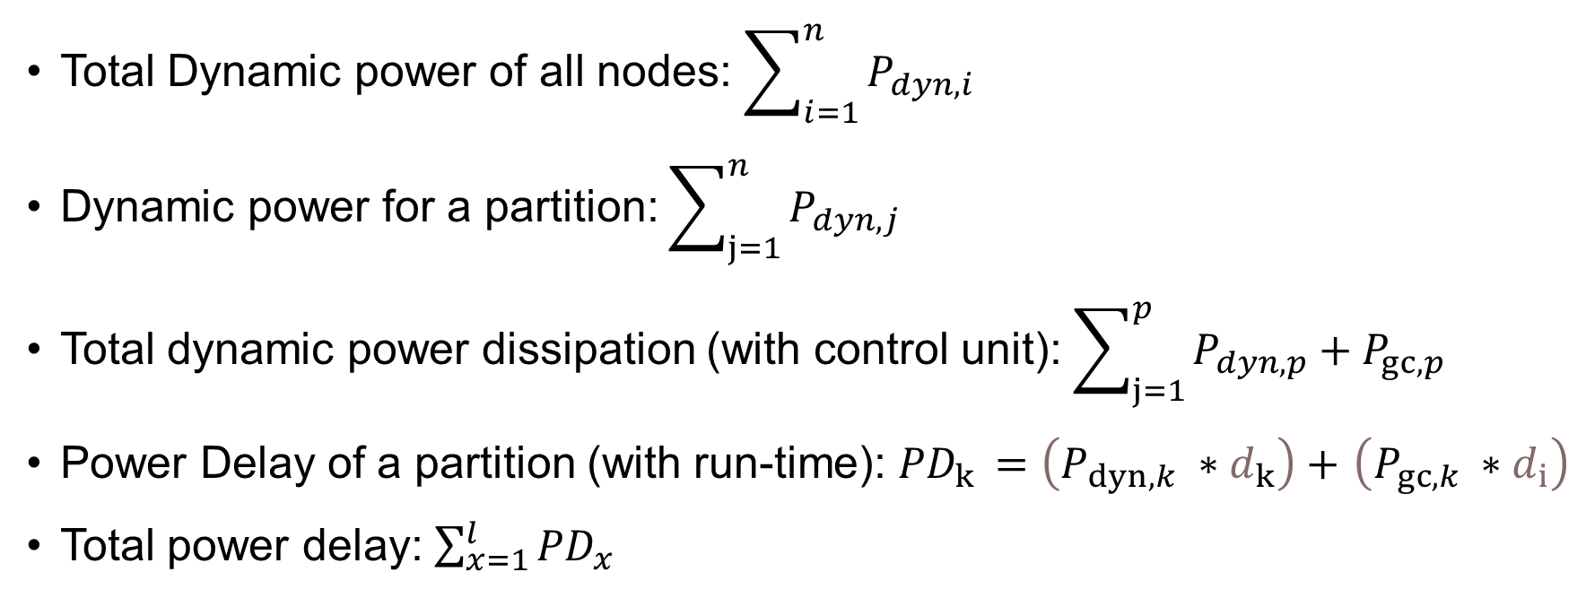
Mathematical Implementation
Total Dynamic power of all nodes: $\sum_{i=1}^{n}{P_{dyn,i}}$
Dynamic power for a partition: $\sum_{j=1}^{n}{P_{dyn,j}}$
Total dynamic power dissipation (with control unit): $\sum_{j=1}^{p}{P_{dyn,p}}+P_{gc,p}$
Power Delay of a partition (with run-time): ${PD}_{k }=\left(P_{dyn,k} ∗d_{k}\right)+$ $\left(P_{gc,k} ∗d_{i}\right)$
Total power delay: $\sum_{x=1}^{l}{{PD}_{x}}$

Slide 20
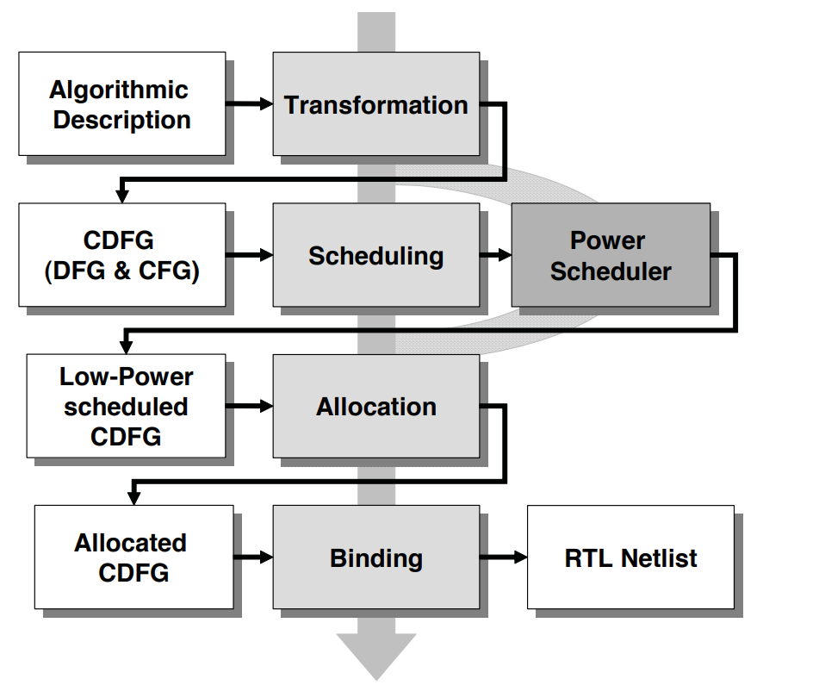
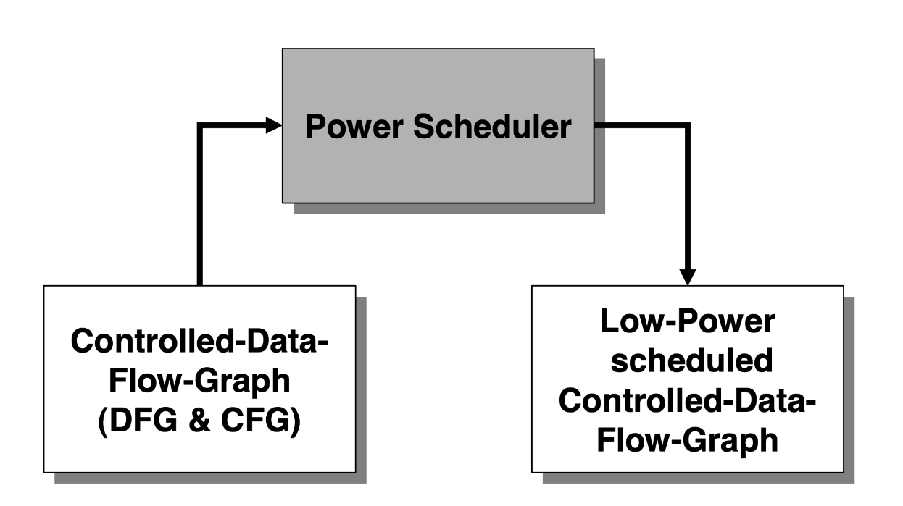
Power scheduler
Alternative scheduling technique for power reduction.
Path-based scheduling technique.
Fig. 4: Integration of Power scheduler in HLS design flow. [1]
Fig. 5: Input and output of Power Scheduler [1].

